Slide 1






Team R
CFA RESEARCH CHALLENGE
Manan Shah
Naman Goel
Ananya Mishra
Hans Castro
Madhur Jiwtani

Slide 2
Content
Recommendation
ESG
Ecommerce growth
Products offerings and development
Valuation
1
2
3
4
5
6
7
8
9
10
Business Description
Investment Summary
Brand Focus
Financial
Analysis
Risk

Slide 3
BUY
1
RECOMMENDATION
US$26.65
🔼31.15%
US$20.32
01/21/2022

Slide 4
End to end commerce solutions
2
BUSINESS DESCRIPTION
Multichannel
Digital Marketing
Brand Analytics
First Party Solutions
Fulfillment
Market Place

Slide 5
3
ENVIRONMENT, SOCIAL AND GOVERNANCE
Environment
(13.9%)
CO₂ emission cost
Reduction in operation cost
Shareholders
Resource use
Emissions
Environmental Innovation
Environment
Workforce
Good
Diversity, Equity and Inclusion
Data Protection Policy
Female % of employees
Net Income per employee
Social
(39.8%)
Governance
35
Human Rights
Management
Social
Community
Need to improve
Governance
(46.3%)
Independent Directors%
Shareholdings
Boards Past Experience
Compensation Structure
Board Meeting Attendance
CSR Strategy
Product Responsibility

Slide 6
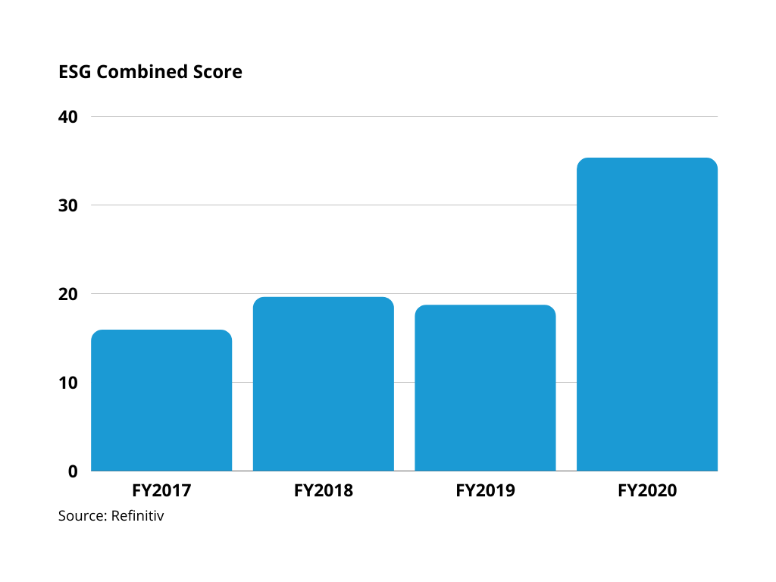
3
ENVIRONMENT, SOCIAL AND GOVERNANCE

Slide 7
4
INVESTMENT SUMMARY
Brand focus
Products offerings and development
Ecommerce growth
Notes:
The three pillars on our recommendation are: ecommerce growth, brand focus and continuous improvement and innovation with their products offerings and development.

Slide 8
ECOMMERCE GROWTH

Slide 9
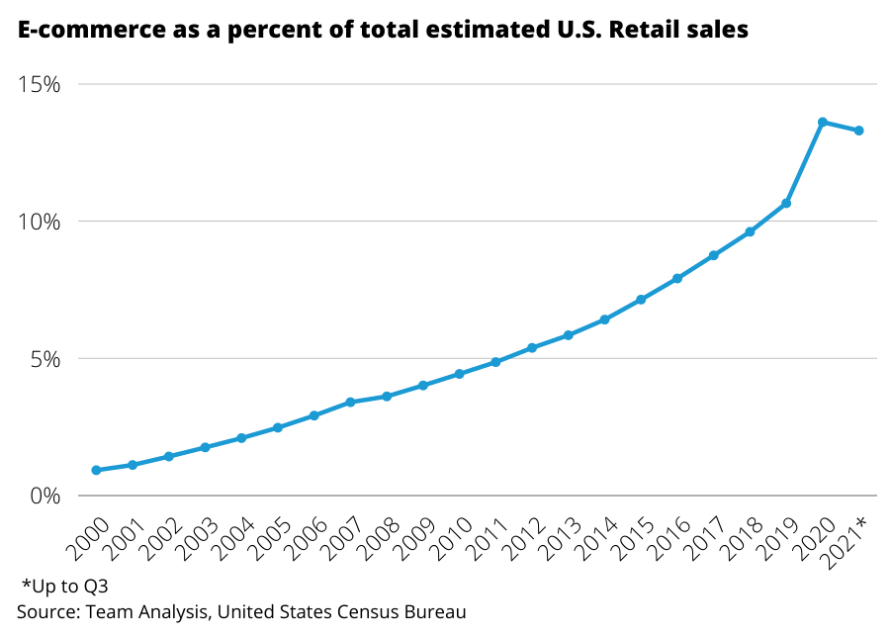
5
ECOMMERCE GROWTH
1
13.3% of total retail sales
2
COVID-19 as a catalyst for growth
3
Change in consumer behaviour
4
Value proposition for brands
Notes:
According to the United States Census Bureau ecommerce represented 13.3% of retail sales, and during 2020, COVID-19 was a catalyst for growth instead of a weakness for the company, the ecommerce industry show a change in consumer behaviour and represents a value proposition for brands.

Slide 10
BRAND FOCUS

Slide 11
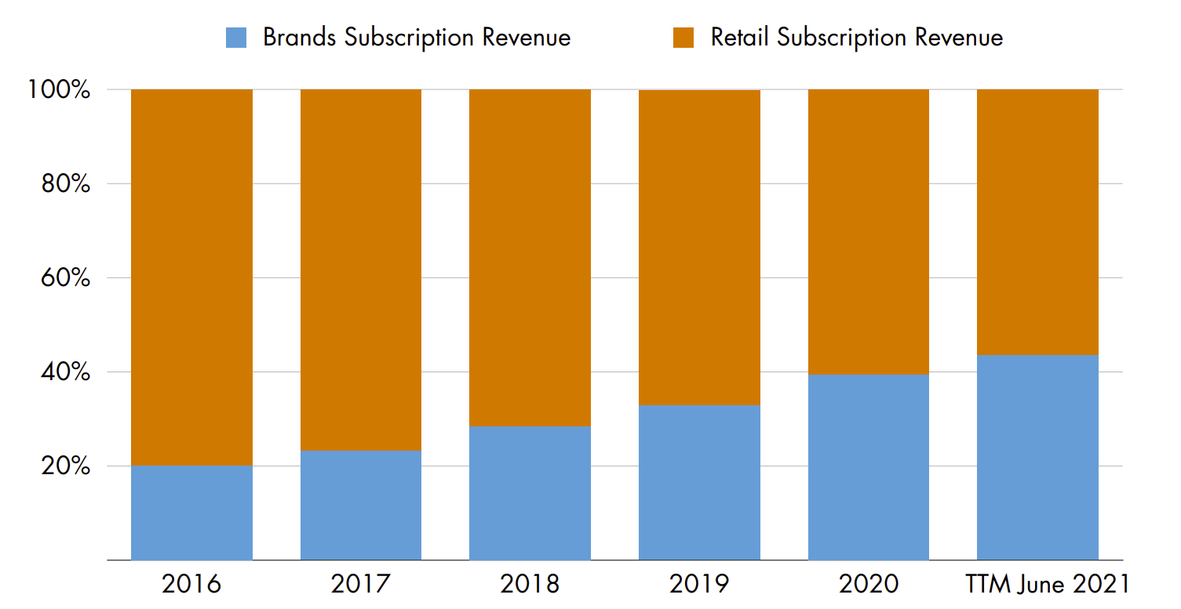
6
BRAND FOCUS
Notes:
In the Software as Service business subscriptions are important, ECOM has focus on brands over retails and now brands represent 40% of the revenues, this show that effectiveness on the the company strategy.

Slide 12
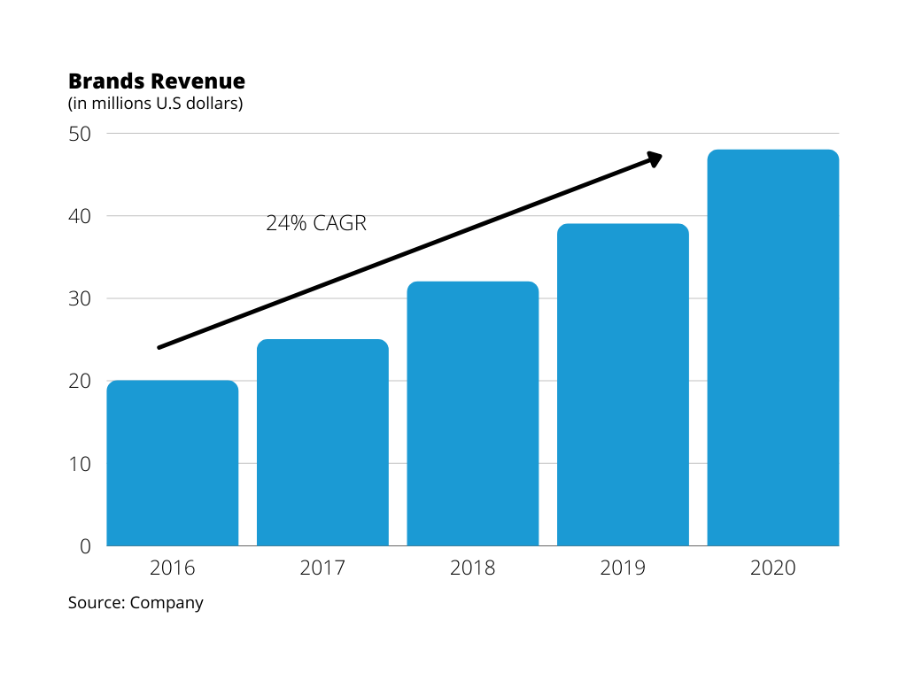
5
BRAND FOCUS
1
More stable
2
Less financially leveraged
3
Higher margins compared to retailers
4
Higher spend potential
Notes:
The revenue has showed an compound annual growth rate of 24% in 5 years.
But why brands? They’re more stable than retailers, they are less financially leveraged and they have higher margins compared to retailers as well as higher spend potential.

Slide 13
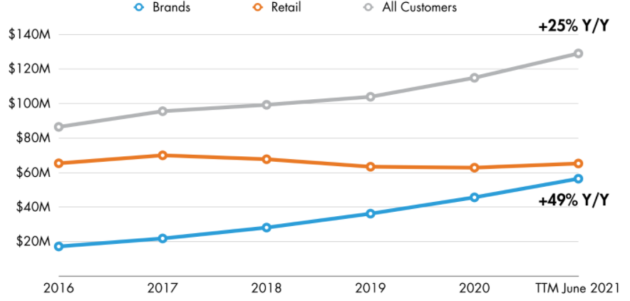
5
BRAND FOCUS
Brands are accelerating Annual Recurring Revenue (ARR) Growth
Notes:
Brand are accelerating annual recurring growth revenue growth, with brands showing an increase of 49%. ECOM show that is capable to maintain and increase good relationships with their customers.
—-- Not read:
The subscription economy is based on relationships - not one-time sales. ARR is the most accurate way to measure relationship changes by new or lost customers, renewals, upgrades, or downgrades.
ARR at the end of 2021:

Slide 14

Notes:
These are some of the brands that work with ECOM.

Slide 15
PRODUCT OFFERINGS AND DEVELOPMENT

Slide 16
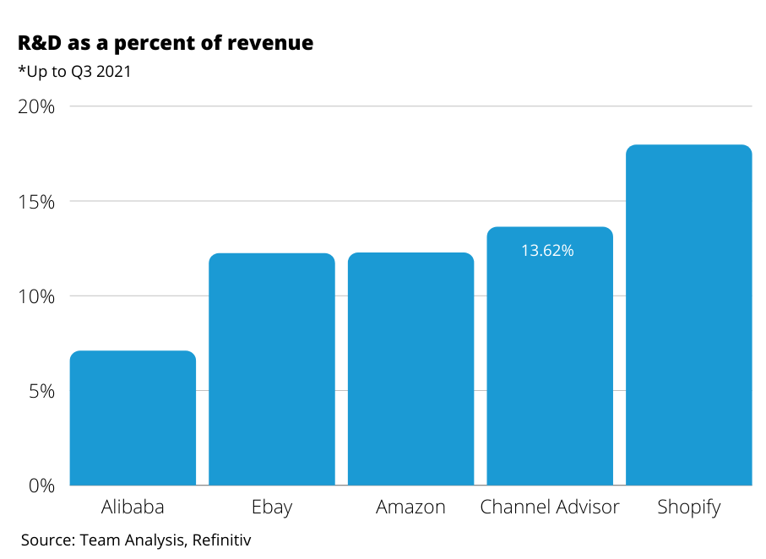
13.62%
1-to-many
7
PRODUCT OFFERINGS AND DEVELOPMENT
Investment in R&D, to develop and improve technology
Multiple integrated solutions
Notes:
ECOM has invested 13.62% on research and development similar to bigger competitors like Amazon and Ebay. And their philosophy is to have just one tool with multiple integrated solutions based on the client’s needed. To give an example, during 2021 they added 100 new channels.

Slide 17
FINANCIAL ANALYSIS

Slide 18
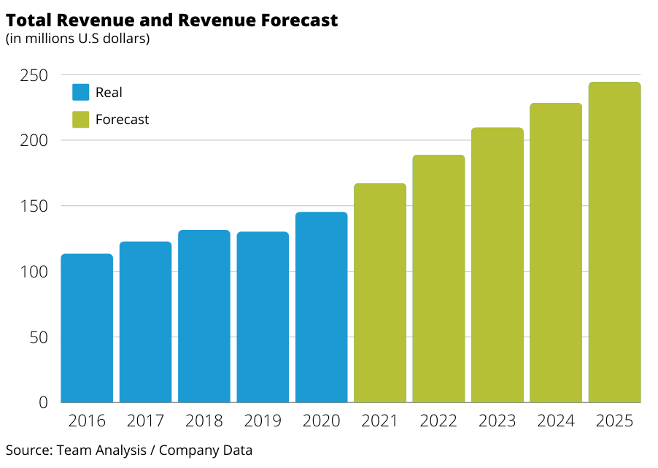
Factors contributing to high revenue projections
8.1
REVENUE ESTIMATE
1
Pandemic and ecommerce boom
2
Recent acquisitions
3
Focus on bigger brands
Notes:
Revenues of ECOM has seen an uptick in last couple of years. It has turned a corner by increasing revenues in 2020 and 2021. A large part of it has been attributed to the pandemic, recent acquisitions and business strategy. We believe that ECOM is on the cusp of booming and then plateauing in revenue growth, so we have taken the estimate of y-o-y quarter to quarter growth and estimate of increase in revenue from q-o-q growth to estimate a 20% increase in revenue y-o-y. We then expect the sales growth to decline by 5% at 15 and sequentially drop to 5% by 2025. This gives us the estimate of 244K by 2025

Slide 19
8.2
COSTS AND EXPENSES
30 %
Costs of revenue
Marketing
50 %
Expenses
General Administration
R&D
*Estimated by 2025
Notes:
With increasing revenue and scale, we expect the cost of revenue to increase at a rate of 2% per annum. By these estimate the cost of revenue will reach 30% by 2025 up from 20% in 2021. Historically, cost of revenue has been low, but as ECOM enters a phase of high growth, the cost of revenue is bound to increase.
Expenses Marketing 50%, 30% and 20% in long run

Slide 20
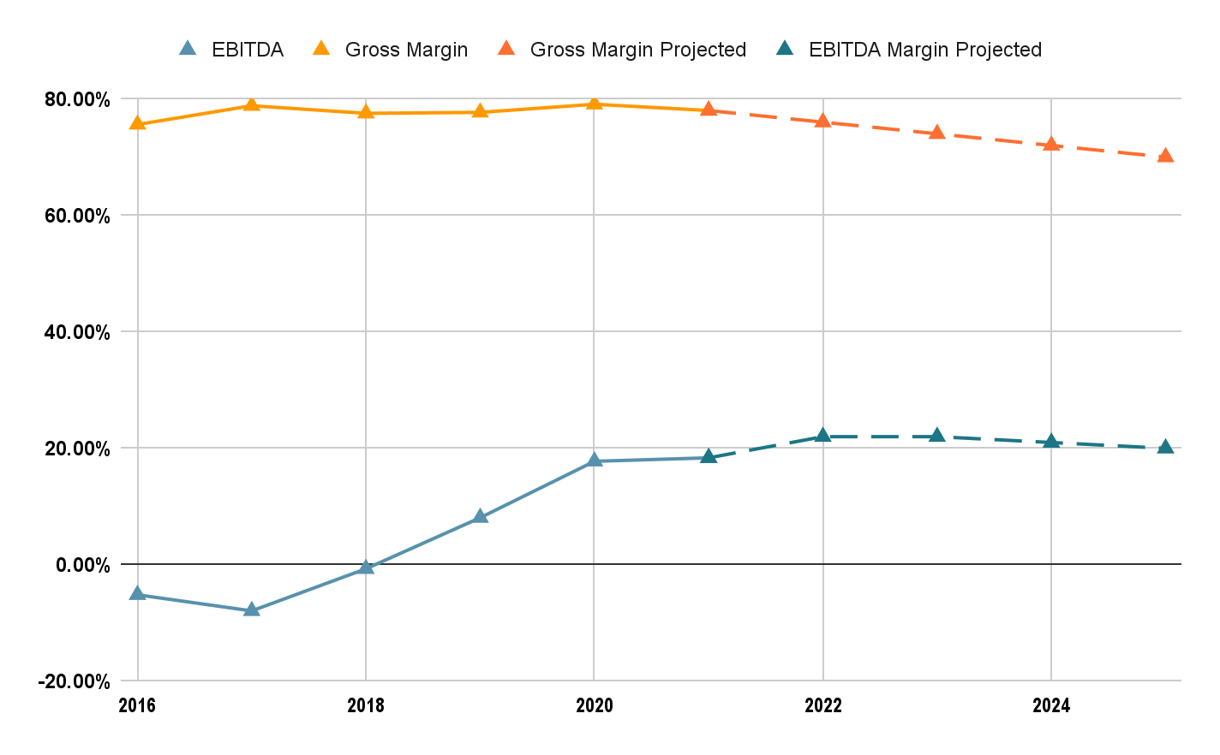
8.3
EBIDTA / NET MARGIN
Notes:
Considering he estimates the EBITDA and the gross margins would increase. But with time these margins would stagnate and resultingly stabilize. EBITDA has moved from negative territory and has actually improved from 2018 to 2020. We believe this momentum will start plateauing and moderating in the next years.

Slide 21
8.4
ASSET/LIABILITIES
Rich Cash Pile
Liquidity
Debt Considerations
Due to low debt, low cost and high revenue, a large chunk of assets are Cash
Due to large cash pile and low debt, liquidity is high and therefore firm does not have distress in short term funding.
Debt levels are very low, with a debt to equity level at 0.01.
1
2
3
Notes:
For asset liabilities consideration, we have
Current ratio stands at 2.97 higher than last year 2.56 (cash increased by 40%). Debt was low at 7 million and the company does not seem to be looking to take debt. Cash pile has hit 100mn up from 71 mn, whicch

Slide 22
VALUATION

Slide 23
9.1
WACC CALCULATIONS
Contribution
Contribution
Justification
1
Cost of Debt
Low Debt (Debt to Equity=0.01) implies cost of debt is not a factor in WACC calculations
2
Credit Risk Premium
High liquidity and low debt suggest credit risk is almost negligible therefore credit risk premium is not factored
3
Market Risk Premium
The market risk premium is determined using Beta and the market returns and risk free rate. The market return is 8.3%, risk free rate at 1.5%. With a Beta at 1.07, we get market risk premium at 7.3%
7.3
4
Inflation
4.0
Considering a very high inflation environment which will have to moderate in future, the factor of inflation is lower than the current considering a medium term perspective
Total
11.3
Notes:
Our WACC calculations are based on 2 factors i.e., Market Risk Premium and Inflation. The other 2 factors which are part of the WACC calculations are redundant in case of channeladvisor and hence not been considered in our calculations because the company doesn’t really have any debt and hence also does not have a credit risk premium associated with it. The other 2 factors which are market risk premium have been calculated using CAPM model with a Beta of 1.07 which gave us a cost of equity as 7.3% and we have considered inflation as 4% based on December 2021 CPI numbers which have been discounted to moderate the long term impact of inflation in United States. This gave us a weighted average cost of capital of 11.3% which we used in our discounted cash flow model.

Slide 24
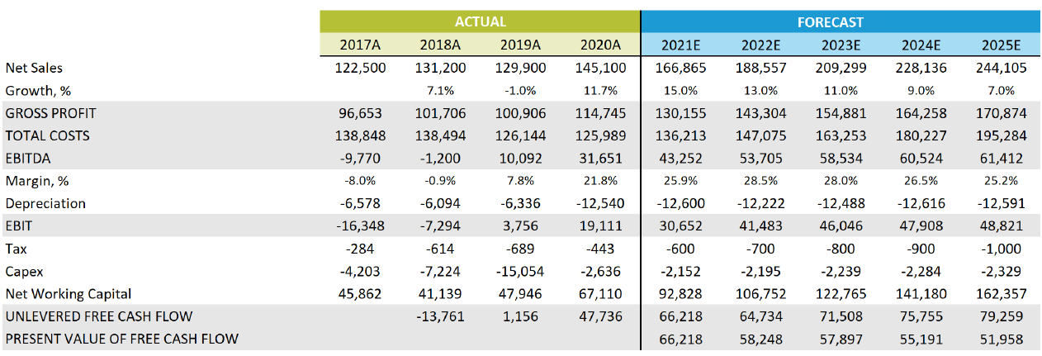
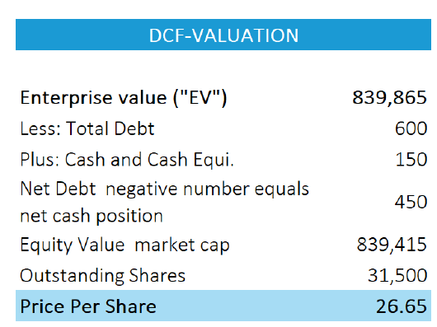
9.2
DCF VALUATION
Notes:
Our Discounted Cash Flow model uses the tradition Free Cash flow to Firm method which has been derived based on reasonable assumptions as per our understanding of the business and their potential growth in the future. The FCFF has then been used to derive the Enterprise value for ECOM. After removing the debt from the EV we were able to compute the equity value of around 840 million which was then divided by the shared outstanding to get a intrinsic value of 26.65

Slide 25


$18.32
$26.65
$33.51
9.3
SCENARIO ANALYSIS
(-10%)
(+31%)
(+65%)
Sustained high inflation
Unable to growth at projected rated
More brands
Double digit growth
Continuous strong ecommerce growth
Major brands
Higher expected growth
Continued COVID-19 consumer behaviour
Notes:
We also conducted a scenario analysis using 3 scenarios. In the base case, we considered our assumptions to be the same as what we used in our DCF analysis and expected the business to grow in the mid to low double digit over the near few years with mildly high inflation. In the bear case, we considered that the ecommerce growth has stunted and the industry is not growing at the rates we expected. Also, we assumed that the company is growing at a much slower pace than anticipated with additional damage being contributed by higher elongated inflation which would hurt long term consumer sentiments. In our bull case, we assumed that the company would have rapid expansion and have high 10’s or low 20’s percentage growth over the coming years further fueled by long term consumer habit changes who prefer the convenience of shopping online causing more brands and retailers to grow there ecommerce presence. Further, we assumed a mild 2% per year inflation which is the target of the federal reserve. The target price in this case if close to $33 which is a 65% increase from our price considered while valuing the company.

Slide 26
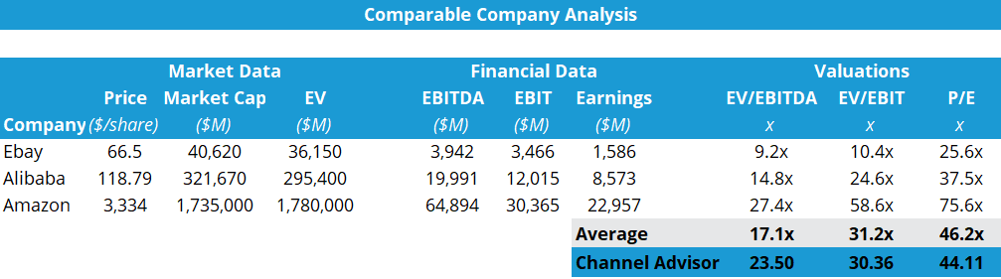
9.4
RELATIVE VALUATION
On one hand, Amazon is a reputable company and on other hand, it has high growth opportunity due to covid and change in customer behaviour. Thus, it has high PE which is increasing the comparable pricing of ECOM.
All 3 valuation metrics supports our buy recommendation
Notes:
We further conducted comparable company analysis using EV/EBITDA, EV/EBIT, and P/E ratios. The price obtained through these ratios are $23.5, $30.36, and $44.11 respectively. The high P/E values of $44.11 obtained is due to the high P/E ratio of Amazon. From above analysis, the relative valuation analysis supports our buy recommendation.

Slide 27
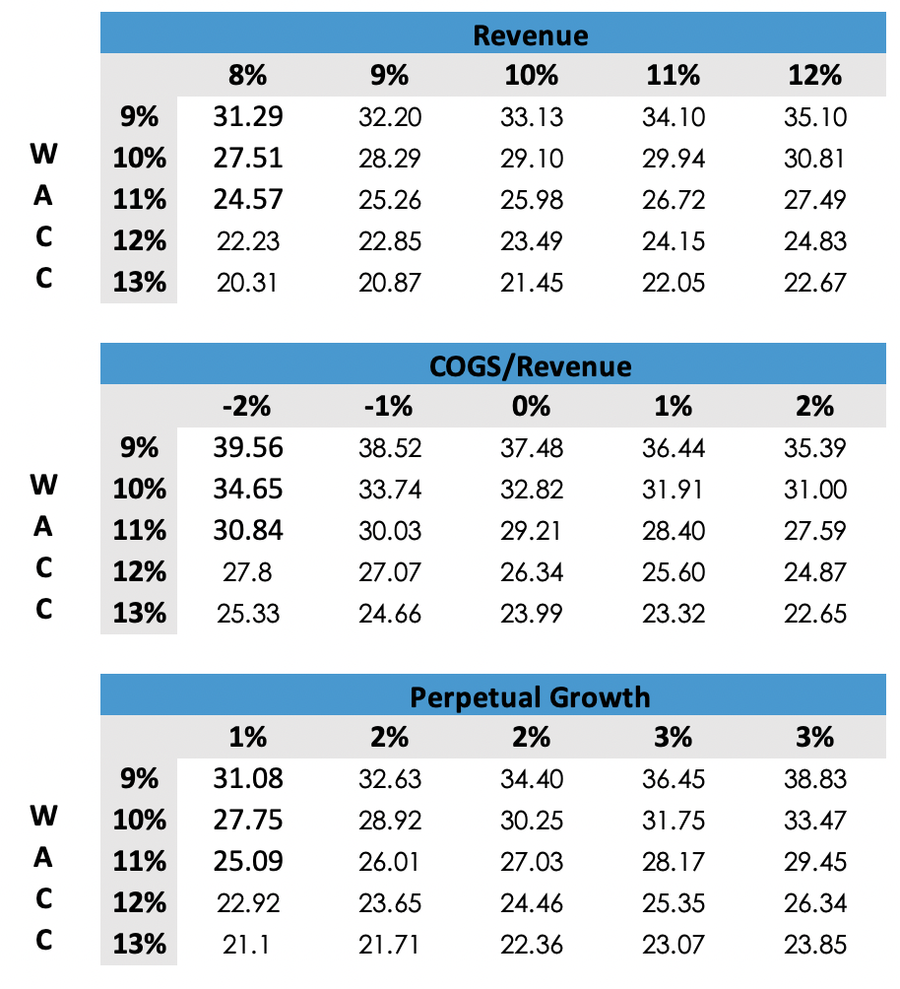
9.5
SENSITIVITY ANALYSIS
In extreme conditions the price of the stock will be less than the current price.
These extreme conditions are highly unlikely considering the change in consumer behavior for online shopping.
Notes:
The sensitivity analysis was conducted to assess the impact of change in key input such as Weighted avg cost of capital, revenue projection, COGS/Revenue, and growth rate on our valuations. The stock price as of 20th January was 20.32 and as per the sensitivity valuations shown above, we can see that in extreme conditions the price of the stock will be less than the current price. Considering the current situation of covid and the change in consumer behavior for online shopping, these extreme conditions are highly unlikely.

Slide 28
INVESTMENT RISK
Notes:
Risk is significant part that needs to be considered in investment. The risk is categorized into 3 section
Operational risk, Market risk and political risk

Slide 29
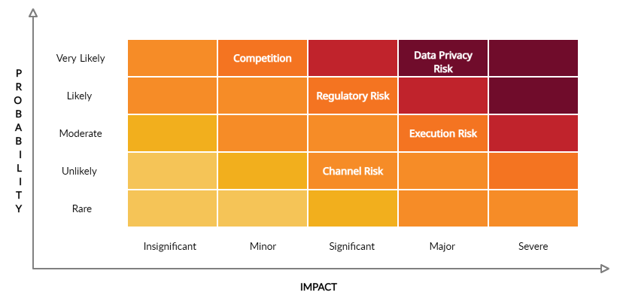
10.4
INVESTMENT RISK SUMMARY
The regulations pertaining to data privacy proves to be the biggest risk for ECOM in obtaining long term goals.
Other risk such as pandemic risk, technology risk, and threat to new entrant have either low probability or low impact
Notes:
This is the heatmap summary of major investment risk for ECOM. Execution risk which is the ability to sustainably execute operational functions by keeping up with the growth is a challenge. This risk can be mitigated by investing and retaining talent who are able to assist with the execution as planned. The impact of Channel risk is high as ECOM is highly dependent on major channels such as Amazon, Facebook and Google.
Threat of new entrant is a major concern to ECOM as the business can be easily replicated with a low investment cost. This risk can be mitigated by onboarding multiple channels onto their platform putting them in a unique position.
Data privacy has been a major point of discussion among consumers, organizations, and governments in the recent past. ECOM can mitigate customers data safety by investing and incorporating cloud technology as the cloud allows organizations to store large amounts of data in a secure and encrypted manner

Slide 30
THANKS!
Any questions?
Notes:
That is from our side. Thank you.

